Slide 1
NATIONAL ASSOCIATION FOR SCHOOLS OF TECHNOLOGY (NAST) COFFERENCE
14 – 17 JULY 2026
TECHNICAL SCIENCES
MR SHONGWE

Slide 2

PURPOSE: ADDRESSING
COMMON CHALLENGES, IMPACTING TECHNICAL SCIENCES
THE TOP 2 COMMON CHALLENGES:
OUR BIGGEST SHARED CRISIS:
TAKE-AWAY MESSAGE FOR ALL DELEGATES:
SECTION B
NOT FOR PRESENATION

Slide 3
THE TOP 2 COMMON CHALLENGES

Slide 4
PRACTICAL ASSESSMENT SKILLS:
C-3
IMPACT
RECOMMENDATION
Limited skills in assessing practical components.
Learners not adequately prepared for vocational demands.
Intensive training programs for educators on practical assessment.
ICT INTEGRATION:
C-4
IMPACT
RECOMMENDATION
Lack of ICT use in teaching abstract concepts.
Learners struggle with visualization and application.
DBE and provincial MST collaboration to provide ICT training and tools.

Slide 5
OUR BIGGEST SHARED CRISIS:

Slide 6
CURRICULUM (CONTENT) PROGRESSION:
C-1
IMPACT
RECOMMENDATION
No proper content progression from Grade 10–12.
Learners face gaps in conceptual continuity.
Restructure curriculum framework for logical sequencing.
CONTENT GAPS FOR EDUCATORS:
C-2
IMPACT
RECOMMENDATION
Educators lack depth in trades-related subject content.
Inconsistent teaching and learner confusion.
Provide specialized content support and professional development (twinning content training with trades)

Slide 7
TAKE-AWAY MESSAGE FOR ALL DELEGATES:
[What message should everyone take home today?]
DATA DRIVEN STRATEGY “LOW RESOURCE SETTING”
Use a low-resource setting environment with constrained resources where services must be delivered through less
THE 2026 NATIONAL TARGET FOR TECHNICAL SCIENCES IS 100 %

Slide 8
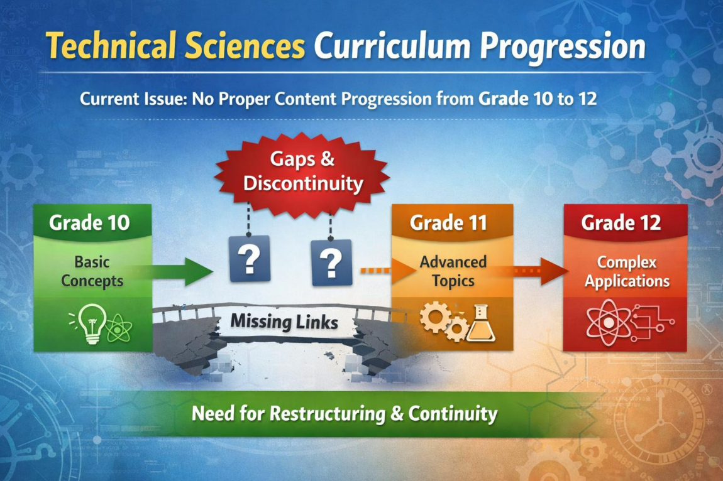
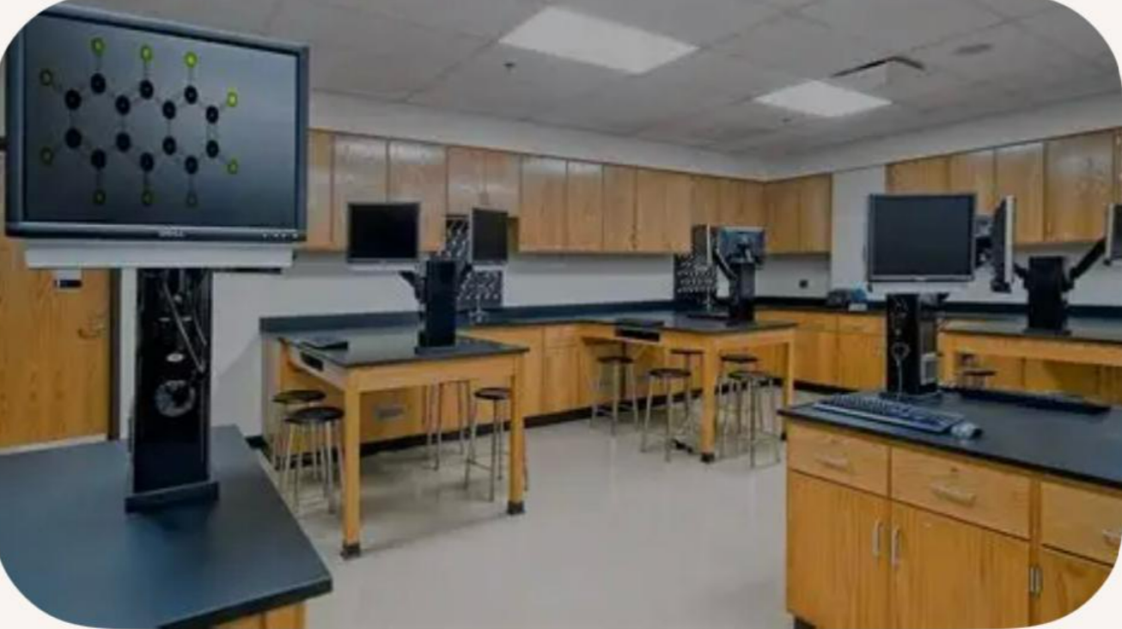
CROSS – CUTTING SUPPORT
ASPECT | ACTION
Curriculum Alignment (DBE) | Restructure content flow across the grades
Educator Training | Continuous professional development
ICT Integration | Provide digital tools and simulations

Slide 9


